Slide 1
CytoAutoCluster
A Study of Mass Cytometry in Cells

Slide 2
Tabel of Contents
Project Overview
Selecting the Right Dataset
EDA Techniques
Visualizing Data
Data Corruption and Splitting
Machine Learning Models
Semi-Supervised Learning & Metrics
Visualizations and Gradio Demo

Slide 3
Project Overview
CytoAutoCluster is a sophisticated tool for grouping cells according to specific traits. Semi-supervised learning improves clustering accuracy and computational efficiency, offering important insights into cellular data. Main characteristics:- Semi-supervised learning uses both labeled and unlabeled data to improve clustering precision. Effective Cell Grouping: Divides cells into separate clusters according to subtle characteristics. Designed for efficiency: Processes extensive data sets quickly and accurately. Interpretability: Clearly illustrates and provides explanations for cluster distributions. Scalability: Handles extensive, intricate datasets while maintaining performance.

Slide 4
Selecting a Right Dataset
Criteria for dataset selection:
Documentation and context.
Number of samples and feature types.
Checking for biases.
•Conduct Exploratory Data Analysis (EDA) to confirm dataset suitability.

Slide 5
EDA Techniques
1. Null vs Non-Null Values
Visualization: Bar Plot
Purpose: Identify missing data to strategize imputation or removal.
2. Class Label Distribution
Visualization: Bar Plot
Purpose: Assess class balance to address potential bias.
3. Histograms of Numerical Features
Purpose: Evaluate patterns like normality, skewness, and outliers.
Key Insights: Identify data trends and unusual observations.
4. Box Plots and Count Plots
Purpose:
Box Plots: Highlight distributions, medians, and outliers.
Count Plots: Show frequency distribution for categorical variables.

Slide 6
Visualization of Data
1. Correlation Matrix
Visualization: Heatmap
Purpose:
Identify relationships and dependencies between numerical features.
Highlight positive and negative correlations that can impact model performance.
2. Skewness and Kurtosis Analysis
Purpose:
Skewness: Measures asymmetry in the data distribution.
Positive Skew: Tail on the right (values concentrated on the left).
Negative Skew: Tail on the left (values concentrated on the right).
Kurtosis: Measures the "tailedness" of the distribution.
High Kurtosis: Heavy tails and potential outliers.
Low Kurtosis: Light tails, indicating fewer extreme outliers.

Slide 7
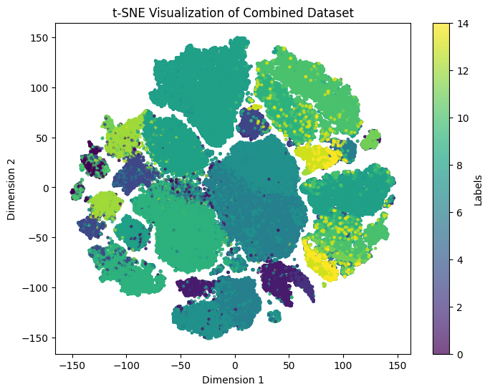
3. t-SNE (t-Distributed Stochastic Neighbor Embedding) Visualization
Purpose:
Dimensionality reduction technique ideal for high-dimensional data.
Preserves local structure and forms visually interpretable clusters.
Useful for exploring data patterns and potential separability of classes.
Key Insights:
Detects inherent clusters or overlaps between different classes.
Reveals hidden structures or anomalies that might not be apparent in the original feature space.

Slide 8
Data Corruption and Splitting
1. Binary Mask and Corrupted Data Analysis
Purpose:
Evaluate model robustness by introducing synthetic noise and missing values.
Test how well the model generalizes under real-world scenarios, such as incomplete or noisy data.
Key Techniques:
Binary Masking:
Randomly mask certain data points to simulate missing values.
Helps models learn to ignore irrelevant or missing features during training.
Corruption Testing:
Introduce controlled noise to test the model’s resilience.
Types of corruptions: Gaussian noise, random data shuffling, or feature dropouts.

Slide 9
2. Data Splitting
Purpose:
Ensure reliable model evaluation by training on one subset of data and testing on another.
Prevent overfitting and ensure generalization to unseen data.
Split Proportions:
70% Training Data:
Used to train the model and optimize its parameters.
Ensures the model learns underlying patterns effectively.
30% Testing Data:
Held out for model evaluation.
Provides an unbiased assessment of model performance on unseen data.

Slide 10
Machine Learning Models
1. Logistic Regression
Purpose:
Acts as a baseline model to compare more complex techniques.
Provides interpretable results by estimating the relationship between features and the target variable using a linear decision boundary.
2. XGBoost (Extreme Gradient Boosting)
Purpose:
Provides robust classification or regression performance by combining the predictions of weak learners (decision trees) sequentially.
3. Future Goal: Advanced Modeling Strategies
Autoencoders
Purpose:
A type of neural network designed for unsupervised learning and dimensionality reduction.
Learns compressed representations of input data, enabling efficient feature extraction.

Slide 11
Semi-Supervised Learning and Metrics
Semi-supervised techniques with Autoencoders:
Crucial for scenarios with limited labelled data, improving feature quality and model performance while reducing noise.
Enables scalable analysis in domains like biomedical research, where labelled data is costly or scarce.
Performance Metrics:
Provide a comprehensive understanding of model strengths and weaknesses.
Help fine-tune models, compare multiple approaches, and ensuring reliability for deployment.

Slide 12
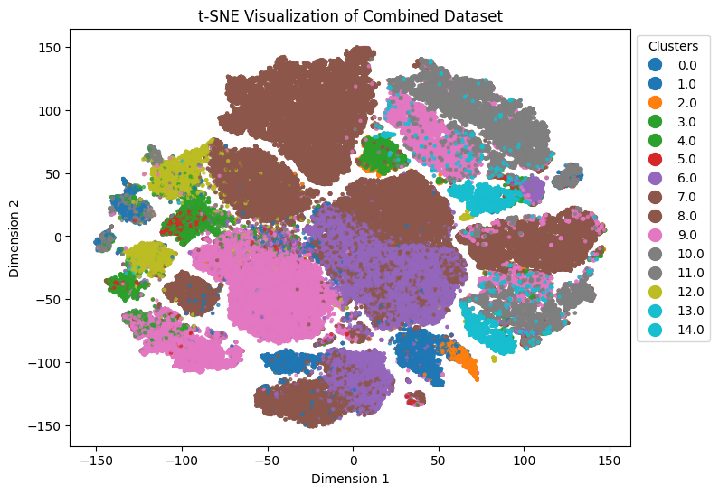
Visualizations and Gradio demo
Final t-SNE Visualization: Post-modeling clustering results.
Gradio Demo: Interactive interface for predictions and analysis.

Slide 13
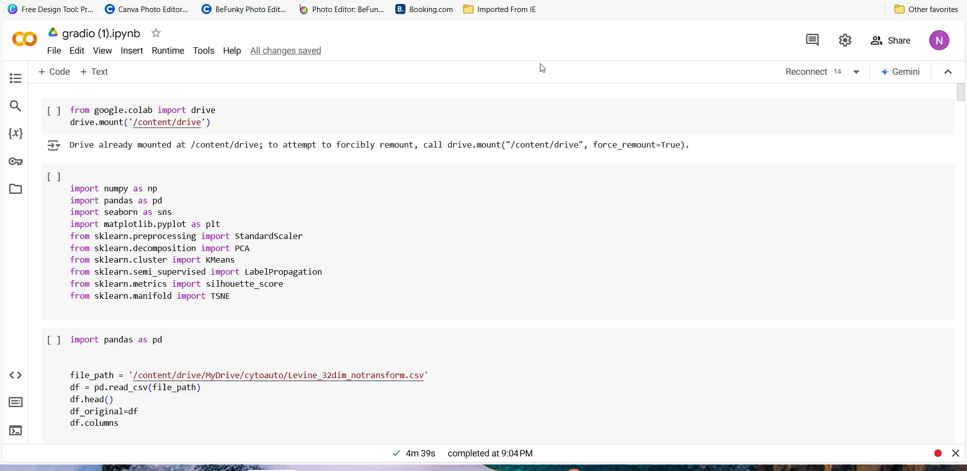

Slide 14


